Slide 1
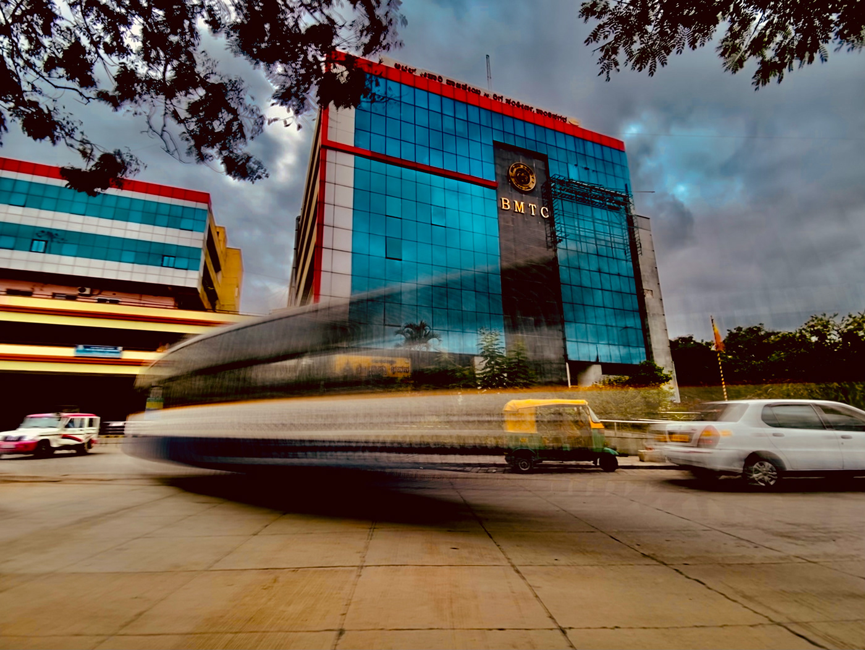
PROJECT TITLE BMTC MANAGEMENT
PINNACLE INSTITUTE OF MANAGENET AND SCIENCE
SUBMITTD BY
BINDUSHREE : 19P3SB7004
SATISH E : 19P3SB7021

Slide 2

PROJECT ABSTRACT
The main aim of the project is to design innovative software, which deals with the “BMTC MANAGEMENT”. The motto of the project is to simplify the job of the administrative people and to render a user-friendly software package. To Develop the records in this project like Staff details, Bus details, Student Pass, Monthly pass, Employee Pass, Day to day transactions, Salary Details and so on.

Slide 3
INTRODUCTION
The main aim of the mini project is to design innovative software, which deals with the “BMTC MANAGEMENT”. The motto of this project is to simplify the job of the administrative people and to render a user-friendly package. The system provides information regarding the bus details and its status. The tedious jobs such as Bus details, Staff Details, Pass Details for Employees, Pass Details for Student, Inventory for Each Bus, Salary Details For Staff can be done in the most easiest way to the administrator. Modifications can be done if there is any change in the program and its schedule. Duplicate information cannot be entered, if done so relating messages will be displayed. Also security is being provided in the most convinent way. Only the authorized user can access the entire data.

Slide 4
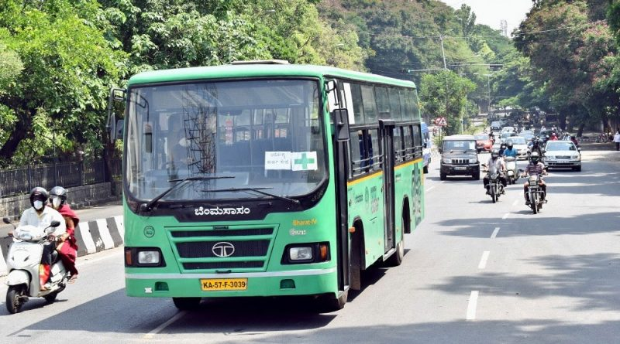
SCOPE OF PROJECT
This project mainly concentrates on maintaining the details of the BMTC Management like Bus details, Staff Details, Pass Details for Employees, Pass Details for Student, Inventory for Each Bus, Salary Details For Staff can be done. Modifications can be done if there is any change in the program and its scheduling. For each program will have its sponsors with their offers and functions. Duplicate information cannot be entered, if done so relating messages will be displayed.

Slide 5
HARDWARE REQUIREMENTS
Processor | Intel I5 1.19 GHz
RAM | 4GB DDR RAM
Hard Disk | 160GB Seagate Hard Disk
Input Devices | Standard Keyboard and Mouse
Output Device | 15’ LED Monitor

Slide 6
SOFTWARE REQUIREMENTS
Operating System | Windows 11 Home Single
Front end tool | VB.NET 2010
Back end tool | SQL SERVER 2010

Slide 7
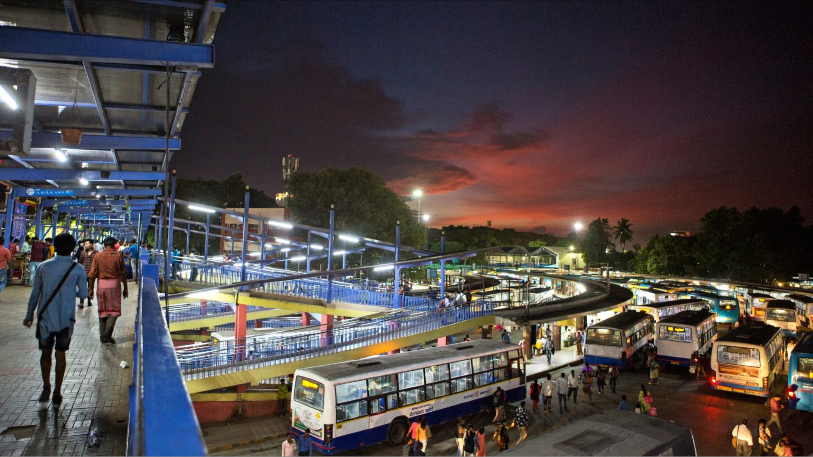
LIST OF THE PROJECT MODULES
Bus Details
Staff Details
Pass Details For Employees
Pass Details For Students
Inventory For Each Bus
Salary Details For Staff
View Records
Final Reports

Slide 8
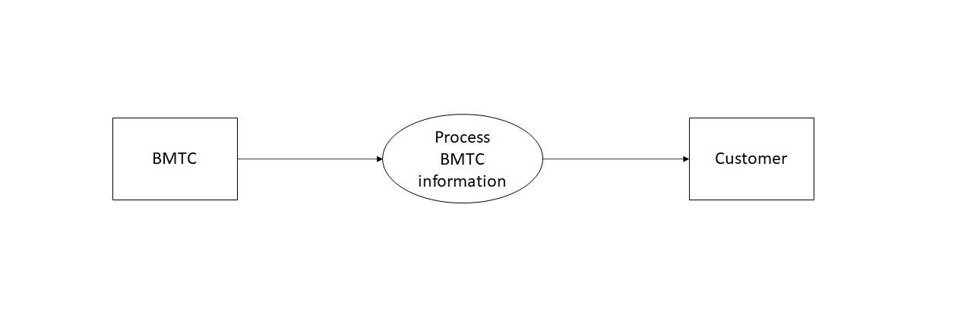
DATA FLOW DIAGRAM
DFD 1

Slide 9
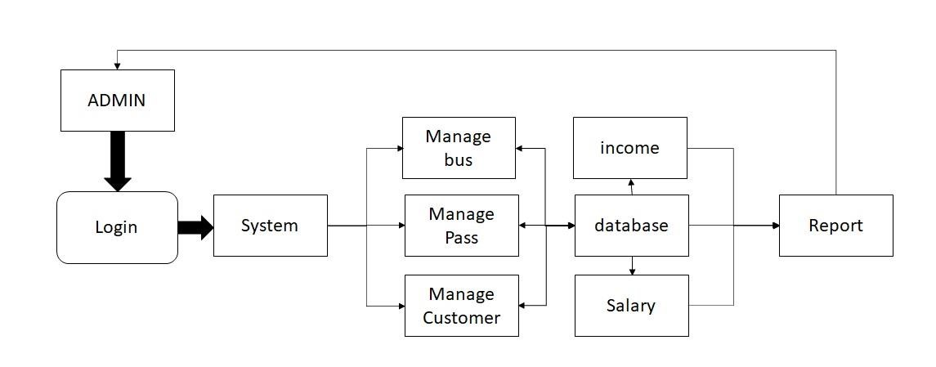
DFD 2

Slide 10
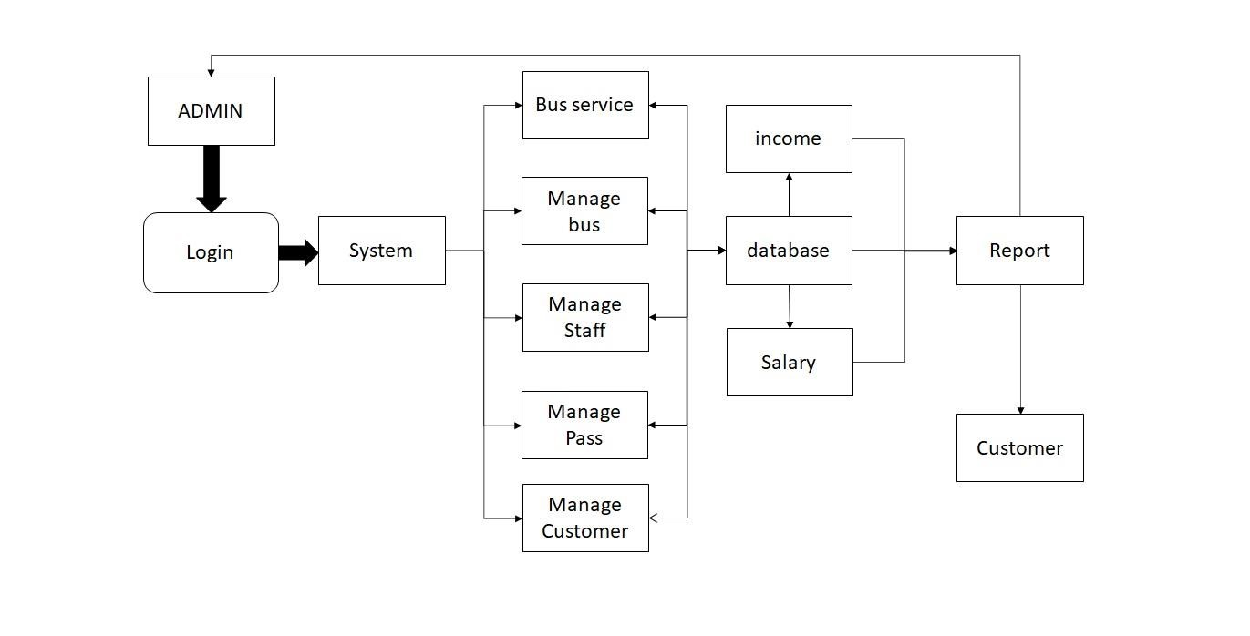
DFD 3

Slide 11
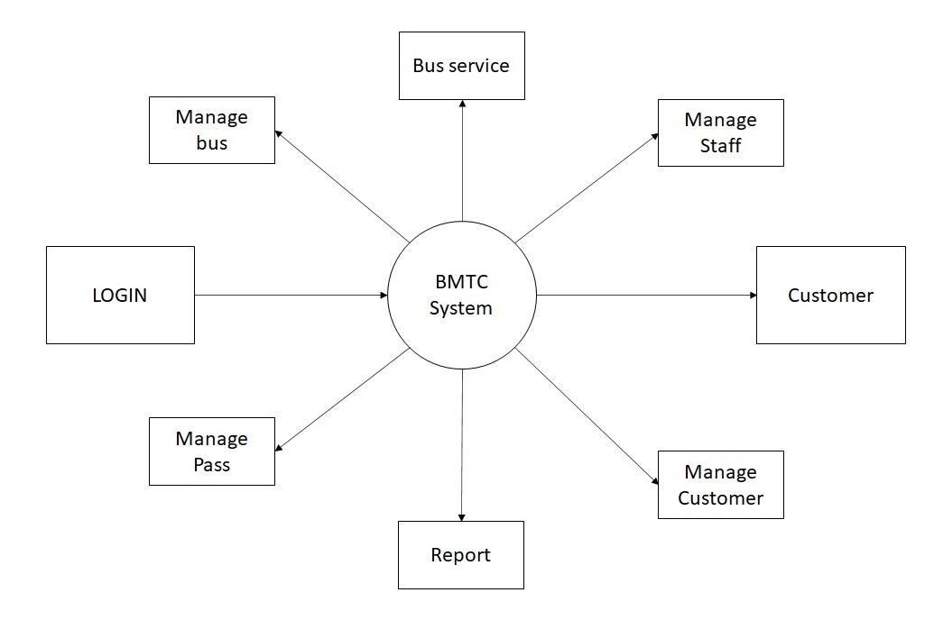
DFD 4

Slide 12
ER DIAGRAM
Name
Password
Login
Login-To
BMTC Managenent
Maintained By
Bus Details
Staff Details
Pass Details
Income and Expenses
Search and Modify
Show Records
Final Reports
X

Slide 13
Name
X
BUS Pass
Total Collections
Address
Staff Details
Transactions
Income for BMTC Management
Contact
Aadhar Card
Daily Collections
Miscellaneous
Name
Address
Pass Details
Contact
Aadhar Card
Name
Address
Student Details
Contact
Aadhar Card

Slide 14
DATABASE TABLES
Login Table
Column name | Data Type | Constraints
Username | Varchar(50) | Primary key
Password | Varchar(50) | Not null
Aadhaar | Numeric(18,0) | Not null
Phone no | Numeric(18,0) | Not null

Slide 15
BUS DETAILS TABLE
Column name | Data Type | Constraints
Bus no | Varchar(50) | Primary key
Route name | Varchar(50) | Not null
Bus Type | Varchar(50) | Not null
Platform | Varchar(50) | Not null
Seat capacity | Varchar(50) | Not null
Stage | Varchar(50) | Not null

Slide 16
DAILY COLLECTION TABLE
Column name | Data Type | Constraints
Date of collection | Varchar(50) | Primary key
Daily pass | Varchar(50) | Not null
Ticket amount | Numeric(18,0) | Not null
Total | Numeric(18,0) | Not null

Slide 17
EMPLOYEE PASS TABLE
Column name | Data Type | Constraints
Pass no | varchar(50) | Primary key
Name | varchar(50) | Not null
Father name | varchar(50) | Not null
DOB | varchar(50) | Not null
SAdd1 | varchar(50) | Not null
Aadhar card | varchar(50) | Not null
Gender | varchar(50) | Not null
Company name | varchar(50) | Not null
Dadd1 | varchar(50) | Not null
Contact no | varchar(50) | Not null
Fees | numeric(18, 0) | Not null

Slide 18
STUDENT PASS TABLE
Column name | Data Type | Constraints
Pass no | varchar(50) | Primary key
Student Name | varchar(50) | Not null
Father name | varchar(50) | Not null
DOB | varchar(50) | Not null
Source Address | varchar(50) | Not null
Aadhar card | varchar(50) | Not null
Gender | varchar(50) | Not null
Company name | varchar(50) | Not null
Destination Address | varchar(50) | Not null
Course | varchar(50) | Not null
Fees | numeric(18, 0) | Not null

Slide 19
MONTHLY PASS TABLE
Column name | Data Type | Constraint
ID no | varchar(50) | Primary key
Name | varchar(50) | Not null
Age | varchar(50) | Not null
Address | varchar(50) | Not null
Validity Period From | varchar(50) | Not null
Validity Period From | varchar(50) | Not null
Fees | numeric(18, 0) | Not null

Slide 20
MISCELLANEOUS TABLE
Column name | Data Type | Constraint
Expensecode | Varchar(50) | Primary key
Reason | Varchar(50) | Not null
Dateofexpense | Numeric(18,0) | Not null
Amount | Numeric(18,0) | Not null

Slide 21
SENIOR PASS TABLE
Column name | Data Type | Constraint
Pass no | varchar(50) | Primary key
Name | varchar(50) | Not null
Father name | varchar(50) | Not null
DOB | varchar(50) | Not null
Source Address | varchar(50) | Not null
Contact no | varchar(50) | Not null
Gender | varchar(50) | Not null
Aadhar card | varchar(50) | Not null
Destination Address | varchar(50) | Not null
Age | varchar(50) | Not null
Fees | numeric(18, 0) | Not null

Slide 22
INCOME PASS TABLE
Column name | Data Type | Constraints
Income ID | Varchar(50) | Primary key
Student Pass | Varchar(50) | Not null
Senior Pass | Varchar(50) | Not null
Employee Pass | Varchar(50) | Not null
Monthly Pass | Varchar(50) | Not null
Total | Numeric(18,0) | Not null
Date | Varchar(50) | Not null

Slide 23
STAFF DETAILS TABLE
Column name | Data Type | Constraints
Staff ID | varchar(50) | Primary key
Staff Name | varchar(50) | Not null
Address | varchar(50) | Not null
Contact | varchar(50) | Not null
Email ID | varchar(50) | Not null
Designation | varchar(50) | Not null
Date of Joining | varchar(50) | Not null
Age | numeric(18, 0) | Not null
Gender | varchar(50) | Not null
Salary | varchar(50) | Not null
Depot | varchar(50) | Not null

Slide 24
STAFF SALARY TABLE
Column name | Data Type | Constraints
Staff ID | varchar(50) | Primary key
Staff Name | varchar(50) | Not null
Designation | varchar(50) | Not null
Fixed salary | varchar(50) | Not null
Month of salary | varchar(50) | Not null
Date of payment | varchar(50) | Not null
Days present | varchar(50) | Not null
Total Salary | numeric(18, 0) | Not null

Slide 25
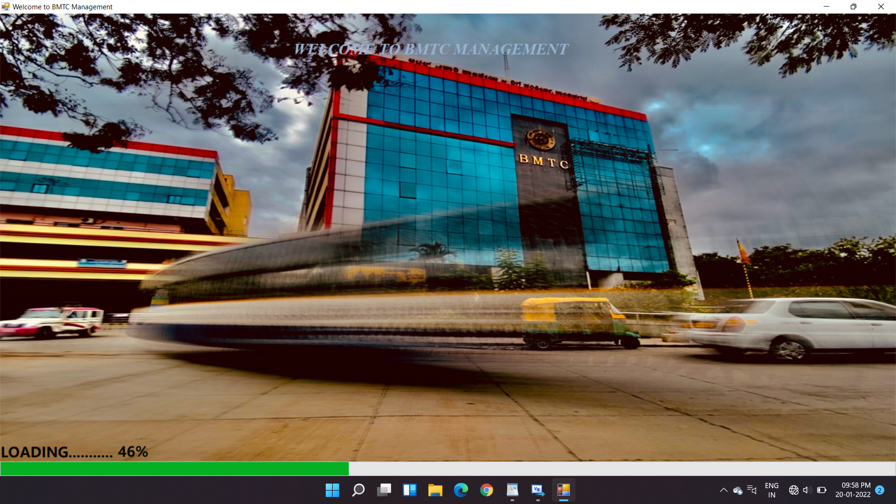
INPUT/OUTPUT SCREENS
HOME PAGE

Slide 26
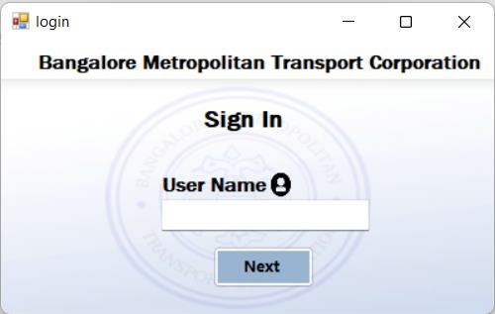
INPUT/OUTPUT SCREENS
LOGIN PAGE

Slide 27
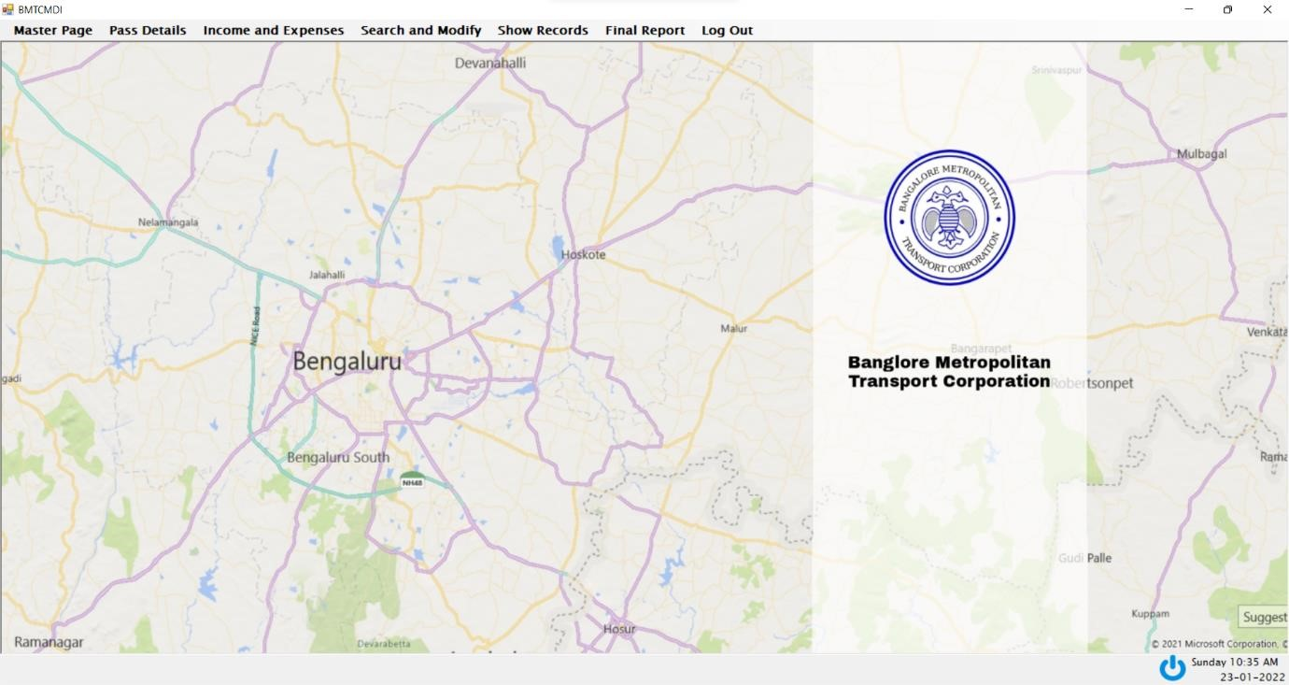
INPUT/OUTPUT SCREENS
BMTC MDI

Slide 28
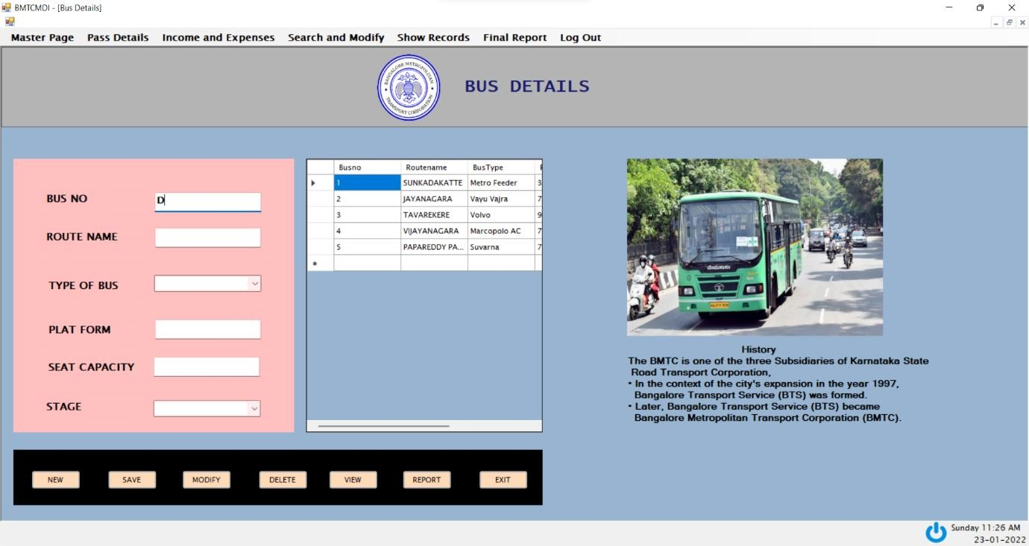
BUS DETAILS

Slide 29
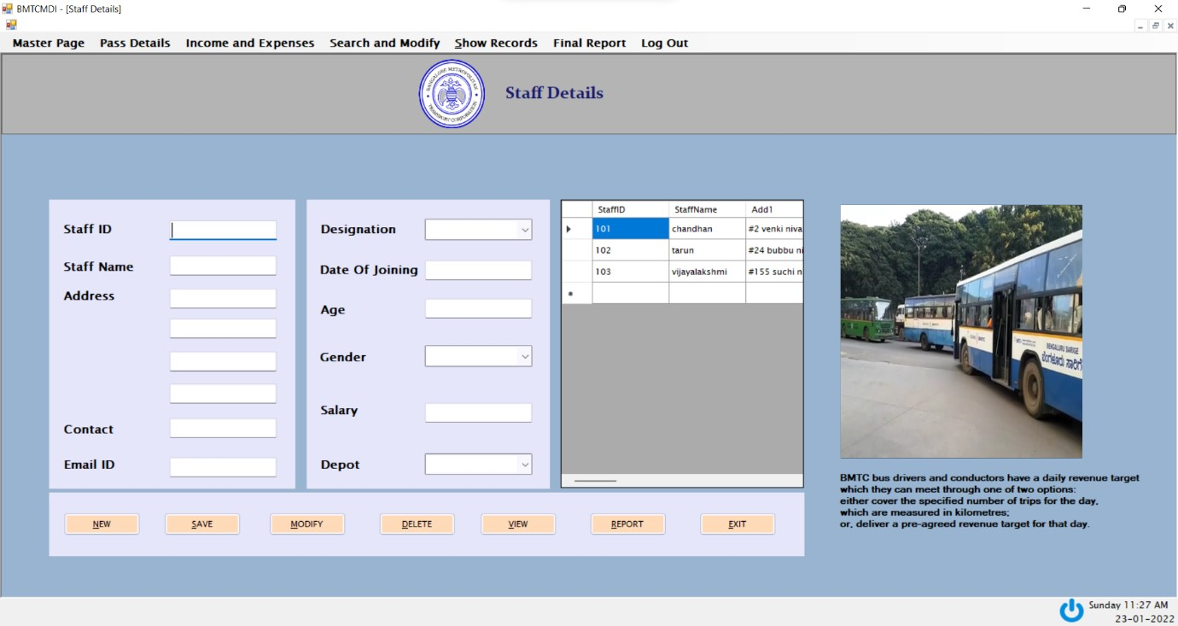
STAFF DETAILS

Slide 30
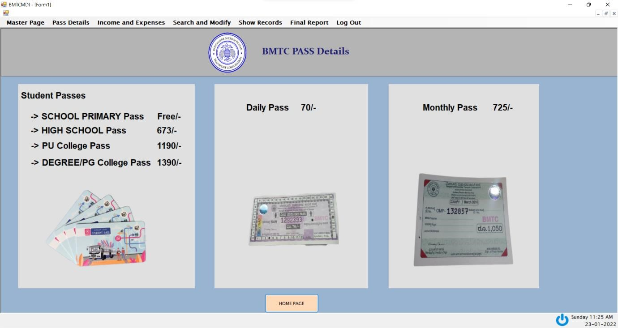
INPUT/OUTPUT SCREENS
PASS DETAILS

Slide 31
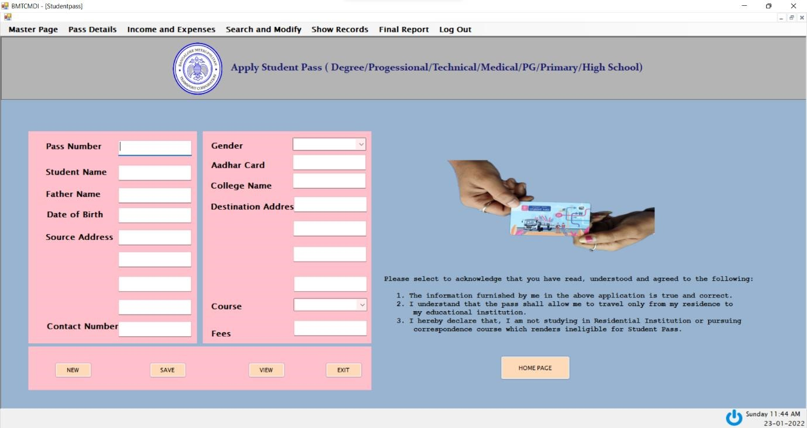
STUDENT PASS

Slide 32
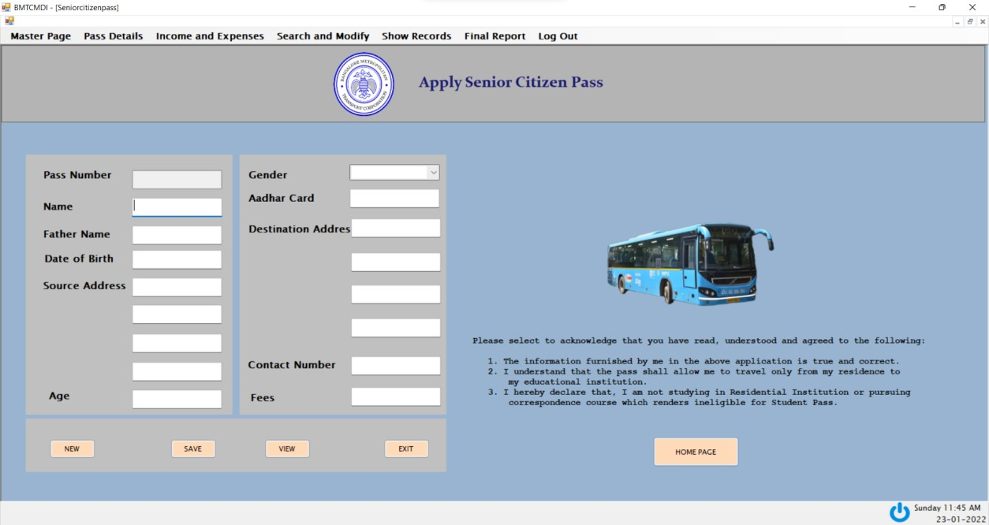
SENIOR CITIZEN PASS

Slide 33
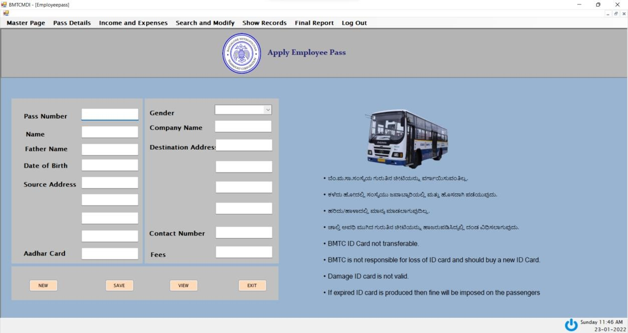
EMPLOYEE PASS

Slide 34
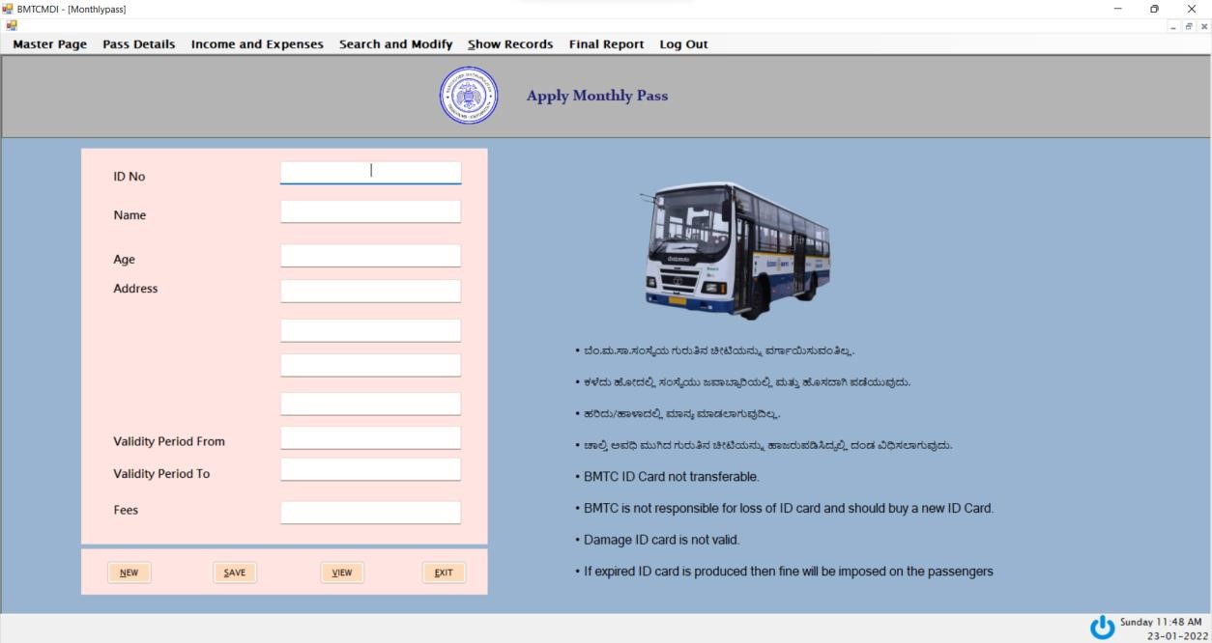
MONTHLY PASS

Slide 35
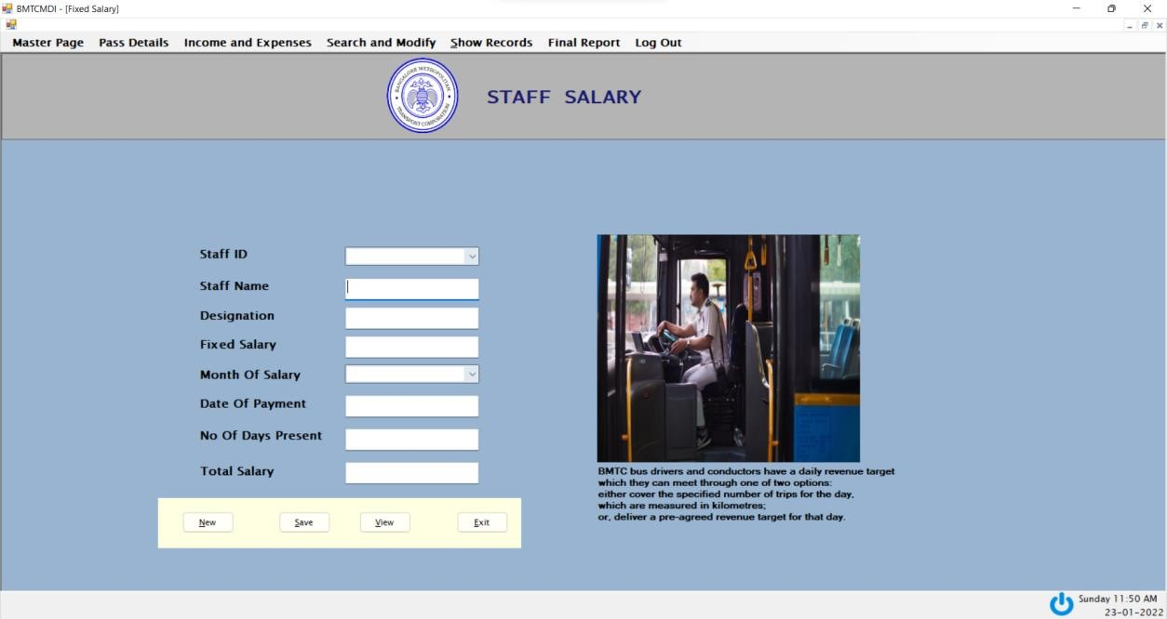
STAFF SALARY PASS

Slide 36
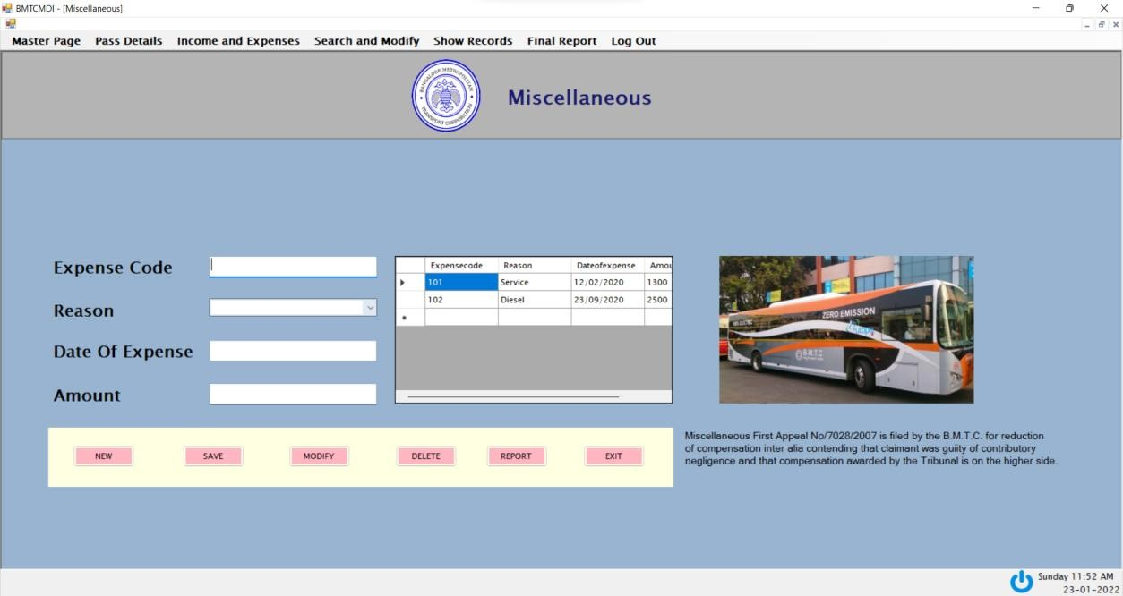
MISCELLANEOUS

Slide 37
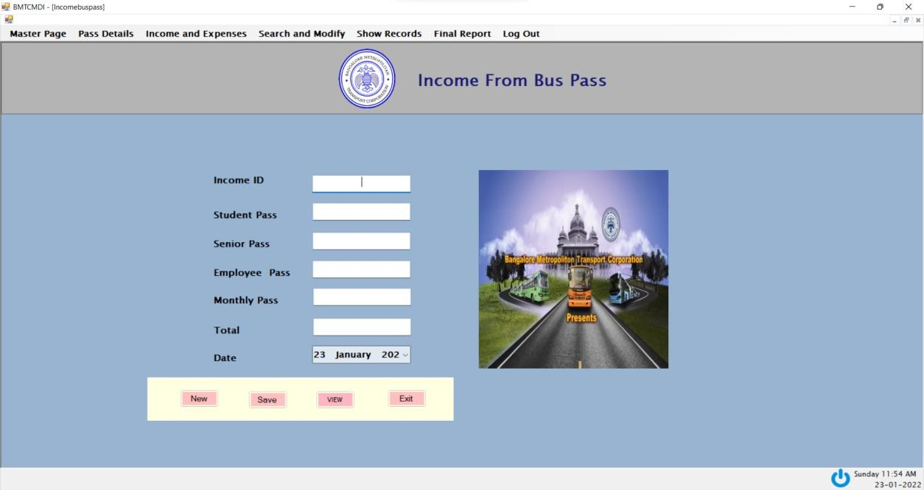
INCOME FORM BUS PASS

Slide 38
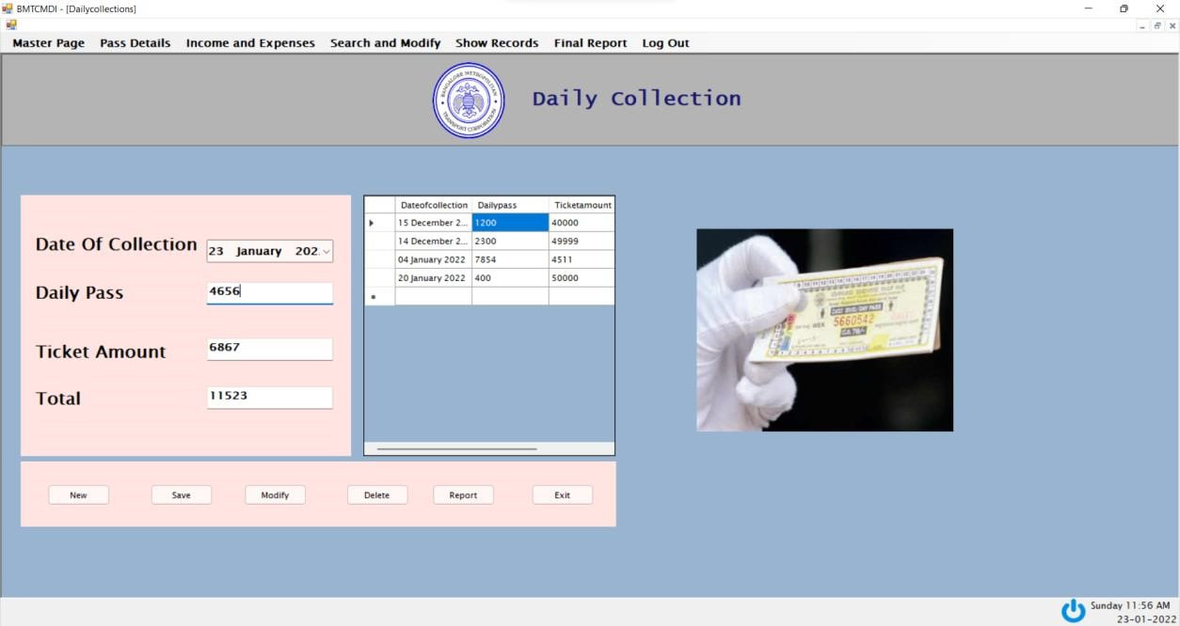
DAILY COLLECTION

Slide 39
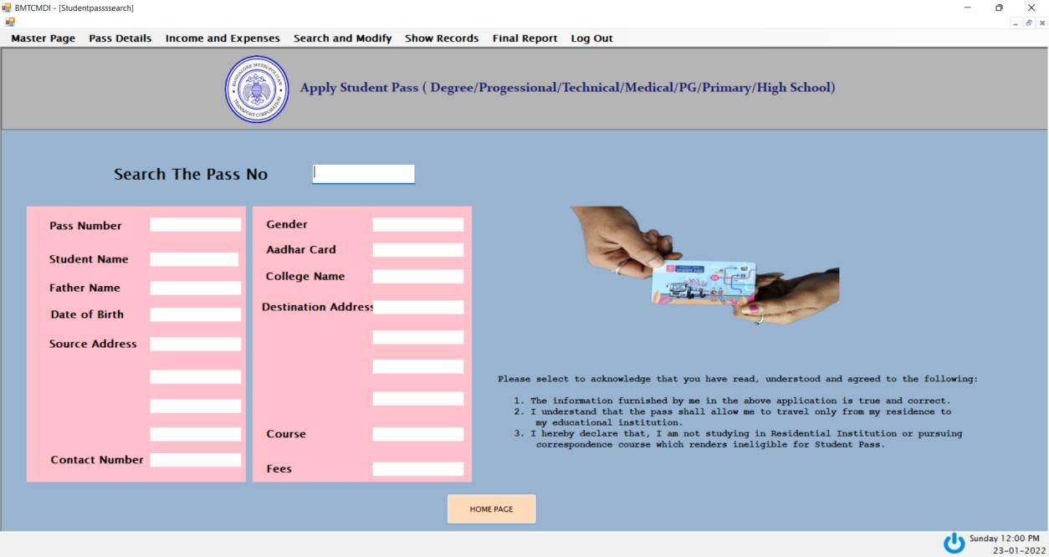
STUDENT PASS SEARCH

Slide 40
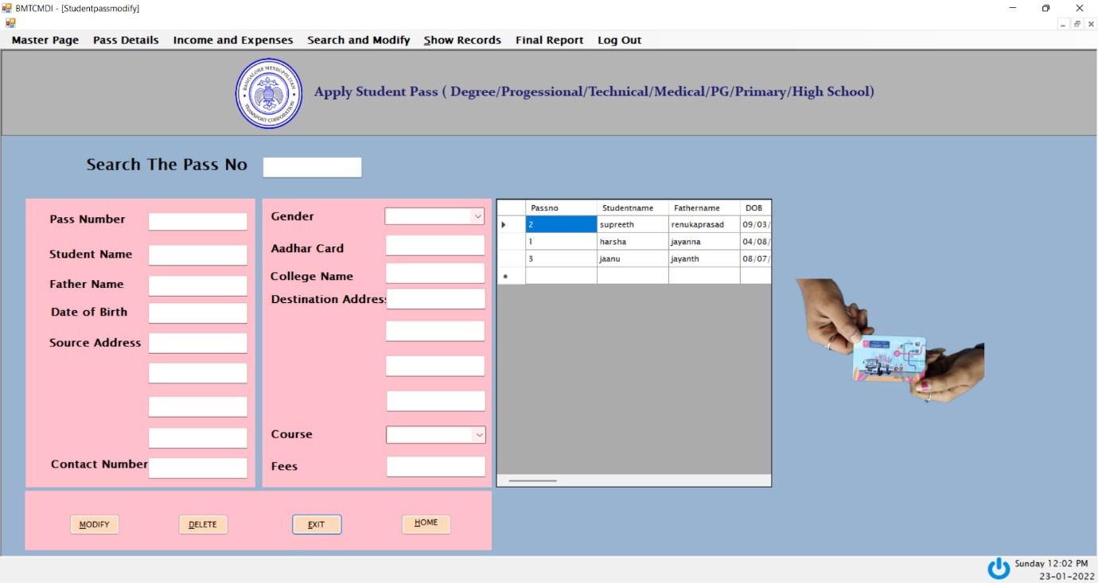
STUDENT PASS MODIFY

Slide 41
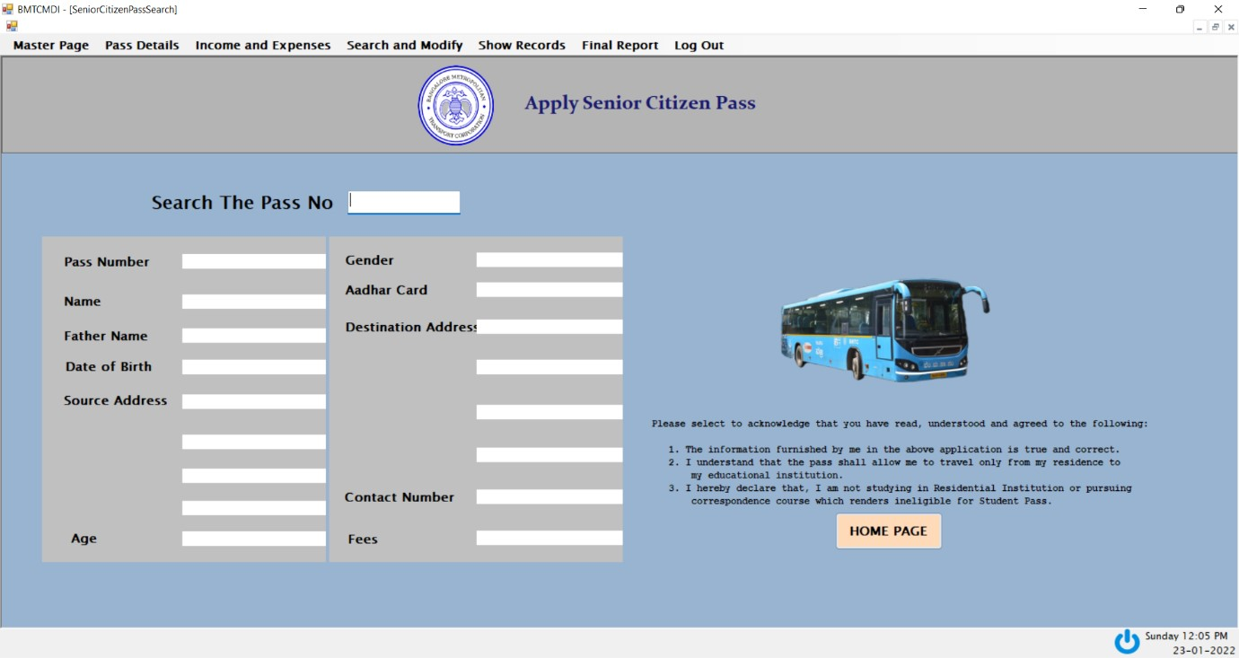
SENIOR PASS SEARCH

Slide 42
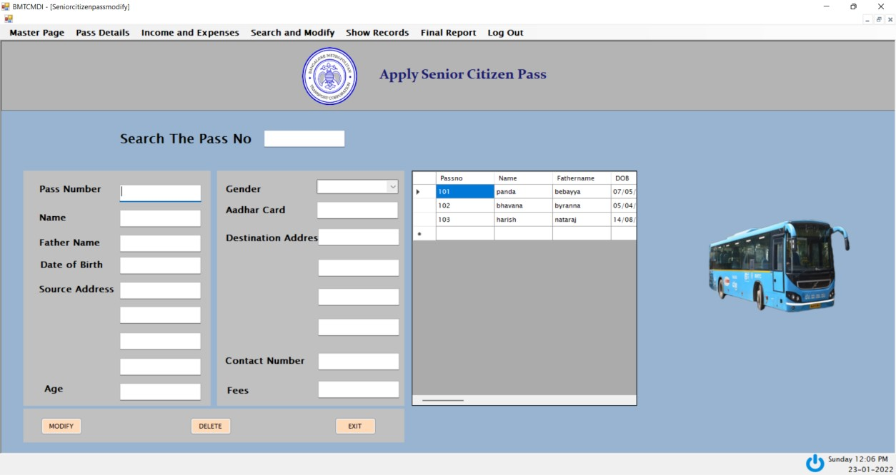
SENIOR CITIZEN PASS MODIFY

Slide 43
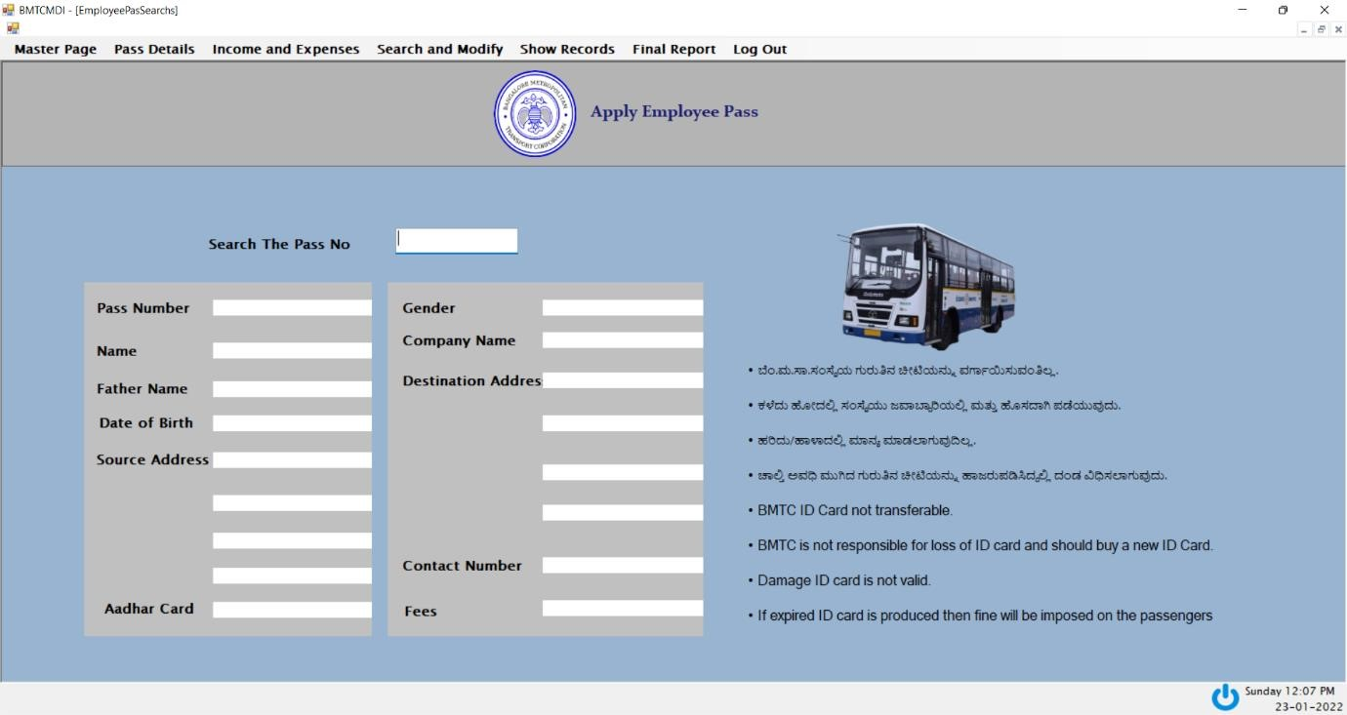
EMPLOYEE PASS SEATCH

Slide 44
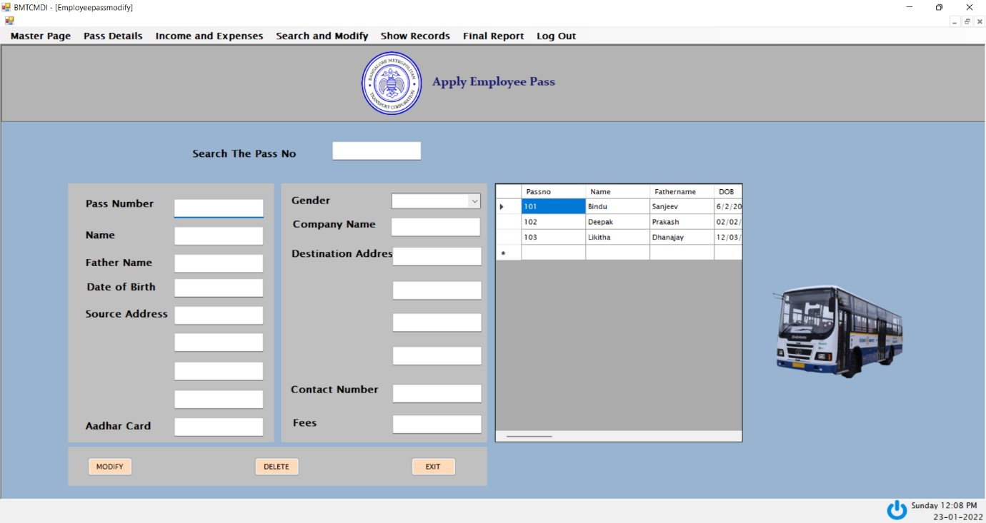
EMPLOYEE PASS MODIFY

Slide 45
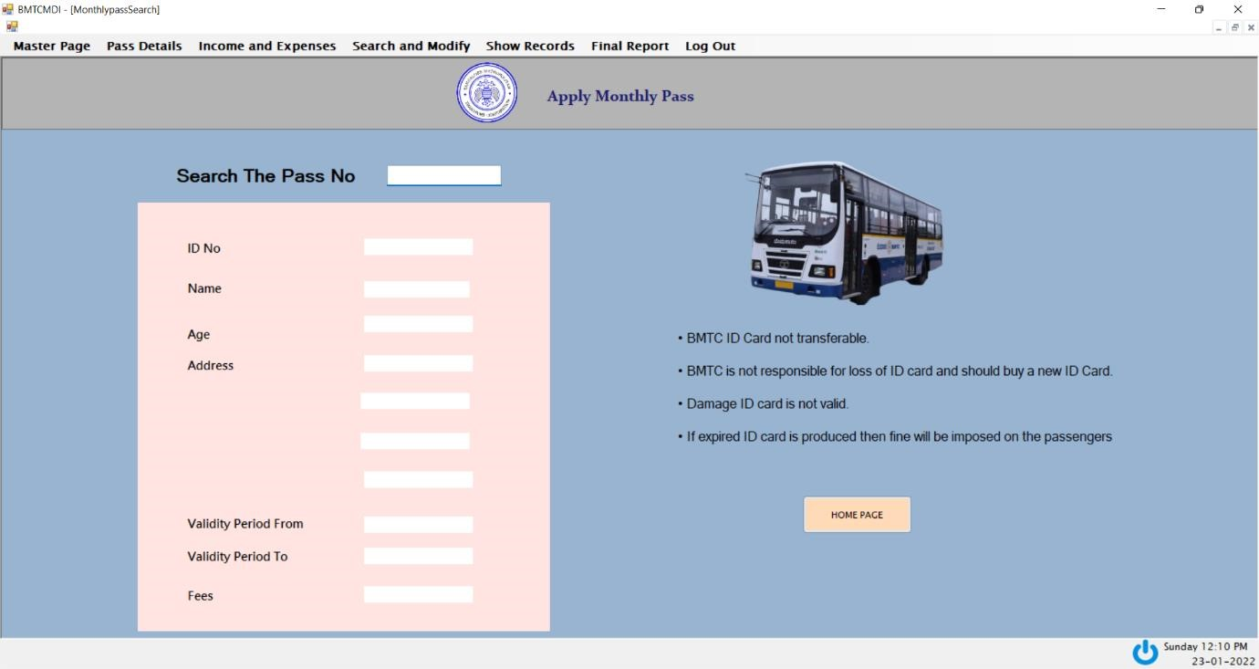
MONTHLY PASS SEARCH

Slide 46
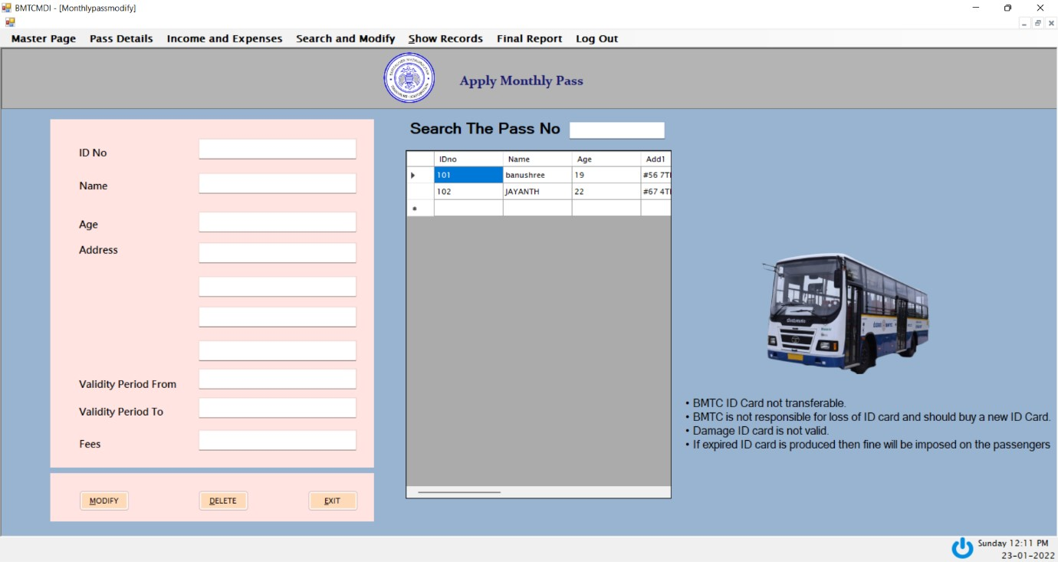
MONTHLY PASS MODIFY

Slide 47
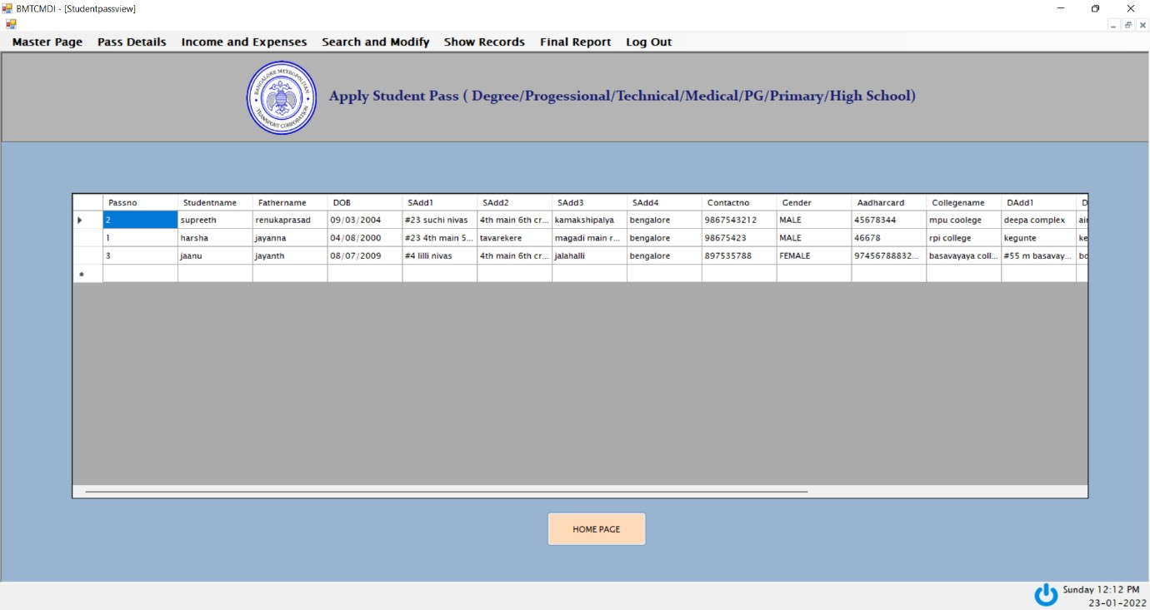
STUDENT PASS RECORDS

Slide 48
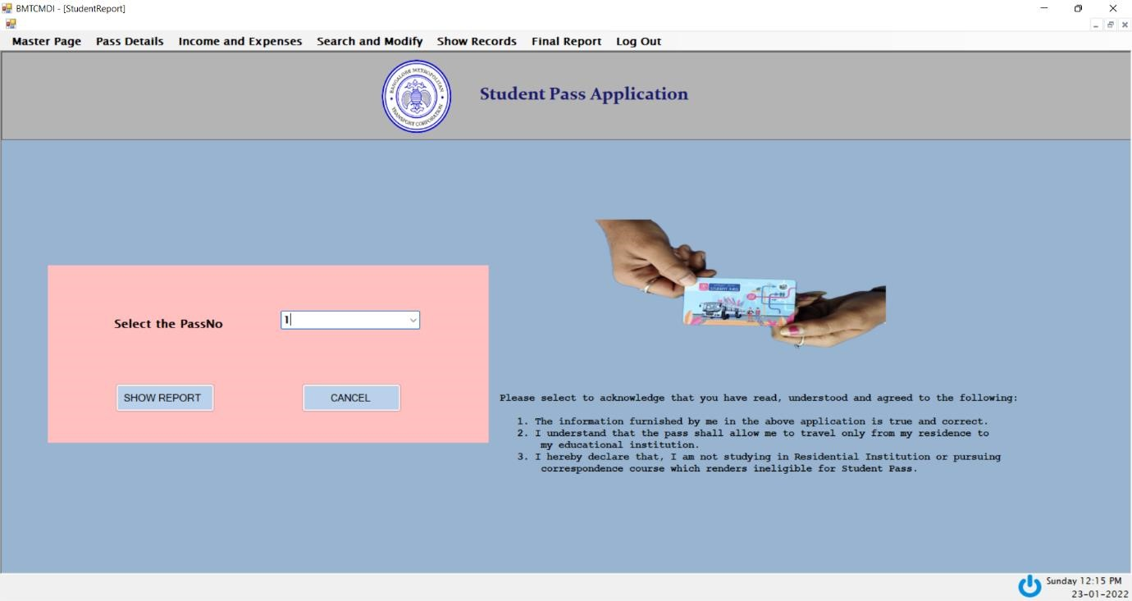
STUDENT PASS APPLICATIONS

Slide 49
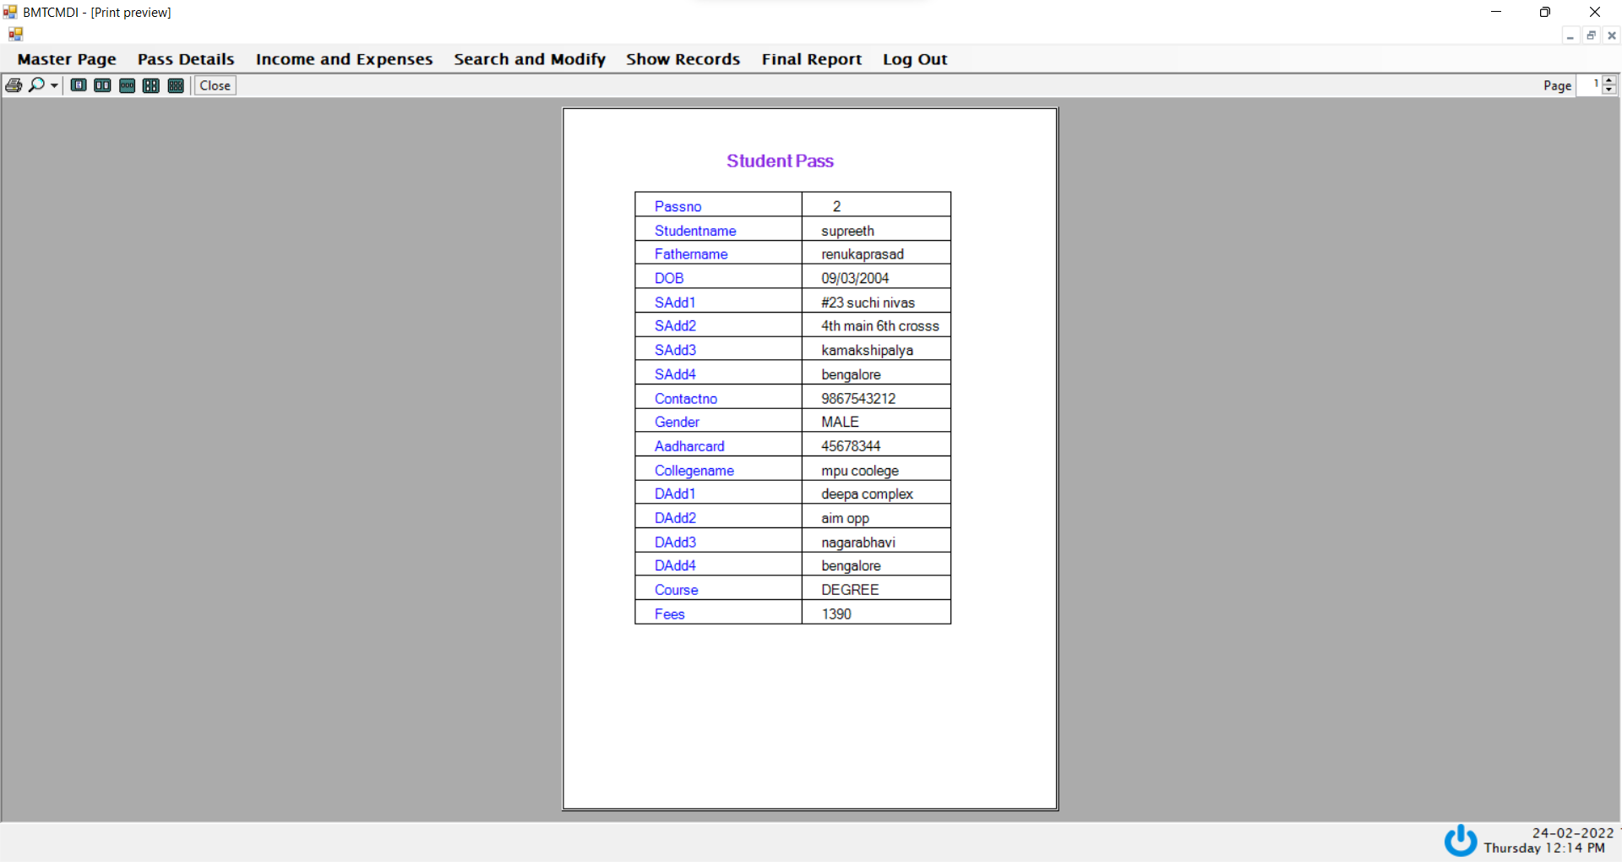
STUDENT PASS APPLICATIONS REPORT PAGE

Slide 50
CONCLUSION
The system is designed in such an extendable fashion to incorporate the future changes into the system easily. Any particular can be added easily and get connected to the menu. The various user-friendly features are introduced in this project. There are several future ideas to develope this application, still in mind. All the links to other forms are generated and are tested with the actual system.
The database connectivity is tested with the user requirements and verified for the validity. The software requirements have been met. Needed documents are generated and adequate documentation has been provided for maintenance and further enhancements. The operation required by the user to operate the system is basic computer knowledge only.
Finally, this is Well graphics project and all the forms are very easy to understand for every computer operator, so that the transactions of the databases for completely recorded in a report in the form of SQL data report. No confusions for the required Final printing reports for all modules in well apped project such as Master Page, Pass Details, Income and Expense, Search and Modify, Show Record, Final Report. These modules are completely validated and 100% verifications done in the frontend tool visual studio and inserted well graphics design.

Slide 51
FUTURE ENHANCEMENTS
Enhancement means adding, modifying, or redeveloping the code to support changes in the specifications. It is necessary to keep up with changing user needs and the operational environment.
Since no system is ever complete, well app for bus management can further developed to include more operations and analysis, as changes are required by end users of the system.
The System can also be developed using VB.NET with the help of Application software.
The System can also be developed for all Police station maintenance.
Graphical Reports can be designed with graphs such as data flow diagram and ER diagram. This will provide clear picture of a ratio of the stored data can be retained for future enhancement.

Slide 52
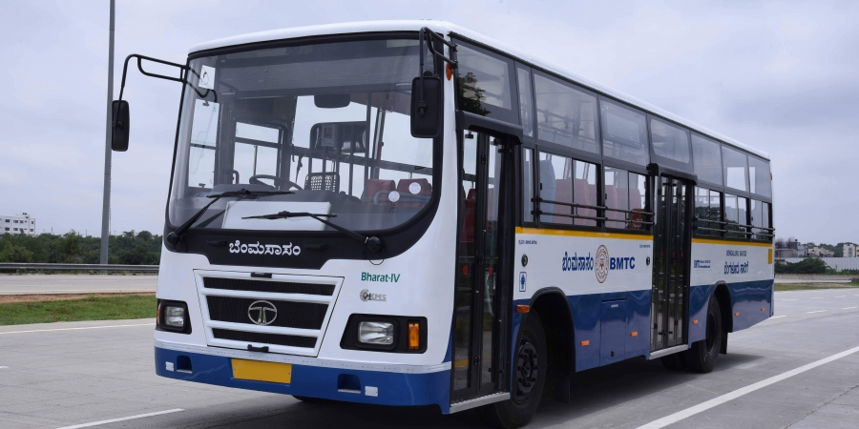
THANK YOU

